Slide 1

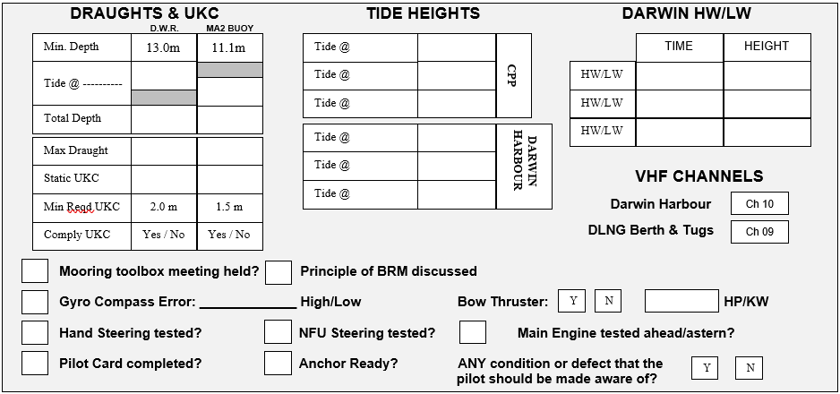
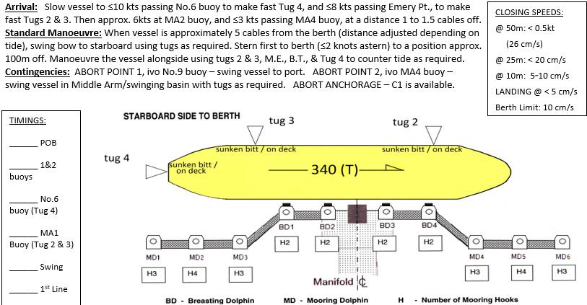
DLNG PASSAGE INFORMATION INWARDS
PIL-PP-14
Partnering in growth, connecting people and supporting potential
NAME OF VESSEL: ___________________________________ DATE: _____________________
POB TIME: ____________________ GT:__________________ DRAUGHT F: _______________
BERTH : ______________________ LOA:_________________ DRAUGHT A: _______________
STARBOARD SIDE ALONGSIDE – Refer to latest NTM for Declared Depths
THE PRINCIPLES OF BRIDGE RESOURCE MANAGEMENT MUST BE ADHERED TO AT ALL TIMES
MASTER:_________________________________ SIGNATURE:___________________________
PILOT:___________________________________ SIGNATURE:___________________________
Teamwork | Respect | Integrity | Honesty | Safety

Slide 2
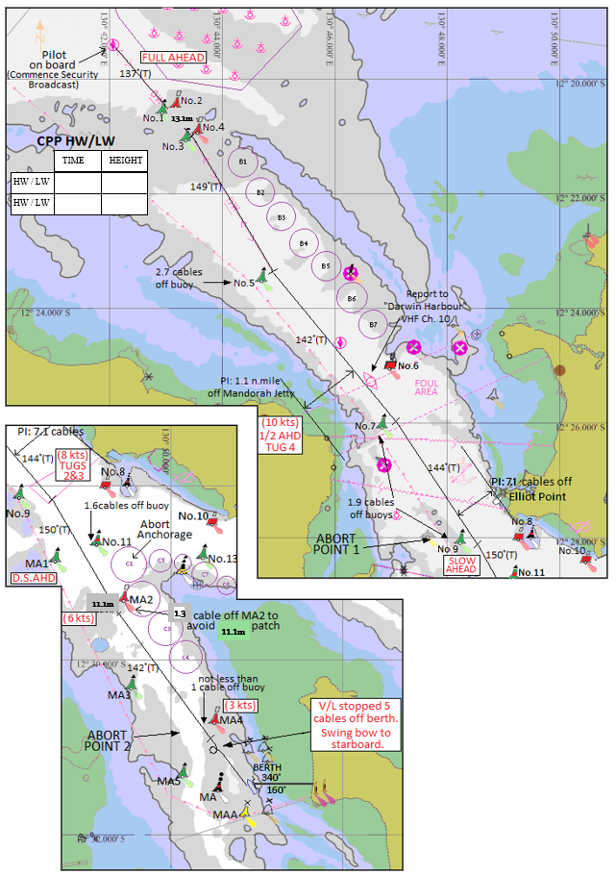
DLNG PASSAGE INFORMATION INWARDS
PIL-PP-14
Partnering in growth, connecting people and supporting potential
BRIDGE TEAM:
MAINTAIN LOOKOUT VISUALLY AND BY RADAR. FOLLOW PILOT PASSAGE PLAN AND INFORM WHEN THERE IS AN OBSERVED DEVIATION FROM THE AGREED PLAN.
*IF IN DOUBT CONSULT PILOT*
MOORING LINES ON ARRIVAL:
ALL LINES ASHORE WITH HEAVING LINES & YOYO GEAR. ONE LINE AT A TIME. SPRINGS FIRST, THEN BREASTS, THEN HEAD/STERN LINES. DON’T HEAVE UP UNTIL MOORING MEN ARE CLEAR OF MOORING DOLPHINS.
MOORING HOOKS: SWL 125t
MOORING HOOK ALARMS SET TO 40t
TUG INFORMATION:
SVITZER STOCKTON & MACQUARIE: ASD 82T
SVITZER PALMERSTON & STOKES: ASD 83T
MATARANKA: ASD 70T
12.5m
BERTHING LIMITS
Wind: 20kts (unless SE'ly then 25kts)
Tide: 2kts
DEPTHS:
D.W.R: 12.5m
Berth: 13.8m
Swing Area (min. Depth at North end of jetty): 11.9m
Critical Depth -West of MA2 buoy
Critical Depth
12.1m
PLEASE NOTE:
* THE CHARTS USED ON THIS PASSAGE PLAN ARE NOT TO SCALE. THESE CHARTS FORM PART OF THE MASTER/PILOT EXCHANGE AND ARE FOR INFORMATION ONLY. NAVIGATIONAL CHARTS AND/OR APPROVED ECDIS SHOULD BE REFERRED TO IN ALL CASES.
* INDICATED COURSES ARE A GUIDELINE ONLY. VESSEL'S ROUTE IS TO BE DISCUSSED DURING THE MASTER/PILOT EXCHANGE AND AGREED TO BY THE MASTER.
* THE SHIP'S POSITION, THE VESSEL'S CONDITION AND HARBOUR TRAFFIC ARE TO BE MONITORED THROUGHOUT THE PASSAGE BY THE BRIDGE TEAM.
* THE BRIDGE TEAM MUST IMMEDIATELY MAKE THE PILOT AWARE OF ANY CONCERNS OR ANYTHING NOT UNDERSTOOD
Teamwork | Respect | Integrity | Honesty | Safety

Slide 3
DLNG PASSAGE INFORMATION INWARDS
PIL-PP-14
Partnering in growth, connecting people and supporting potential
DARWIN PILOT PASSAGE PLAN
Route: Outer Pilot Boarding Ground to DLNG
INWARD BOUND
TOTAL DIST 14.6nm
Waypoint Name | LAT | LONG | Course x Distance to next Waypoint | Total Distance to Waypoint | Comments
OPBG | 12º 19.561’ S | 130º 42.042’ E | 137º x 2.1nm
3&4 Buoys | 12º 21.108’ S | 130º 43.518’ E | 149º x 2.6nm | 2.1nm
No.5 Buoy | 12º 23.344’ S | 130º 44.891’ E | 142º x 1.6nm | 4.7nm
IPBG (TUG 4 rendezvous) | 12º 24.616’ S | 130º 45.907’ E | 142º x 1.7nm | 6.3nm
No.7 Buoy | 12º 25.951’ S | 130º 46.975’ E | 144º x 2.7nm | 8.0nm | Pass 1.1nm off Mandorah Jetty
No.9 Buoy (TUG 2 & 3) | 12º 28.151’ S | 130º 48.609’ E | 150º x 1.6nm | 10.7nm | Pass 0.7nm off Elliott Point
MA2 Buoy | 12º 29.545’ S | 130º 49.432’ E | 142º x 1.6nm | 12.3nm | Pass 0.13nm off MA2 (clear of critical depth)
MA4 Buoy | 12º 30.844’ S | 130º 50.473’ E | 144º x 0.7nm | 13.9nm | Pass 0.1nm – 0.15nm off MA4
DLNG Berth | 12º 31.434’ S | 130º 50.913’ E |  | 14.6nm
Teamwork | Respect | Integrity | Honesty | Safety

