Slide 1

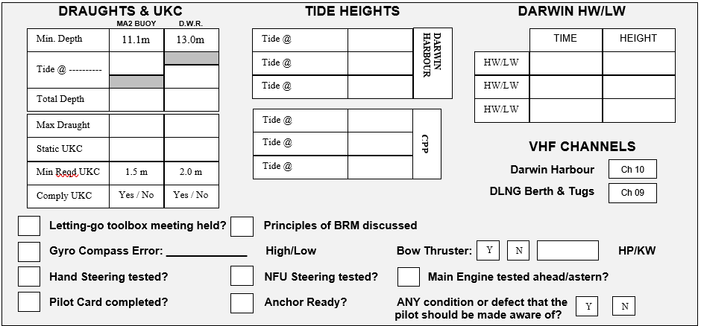
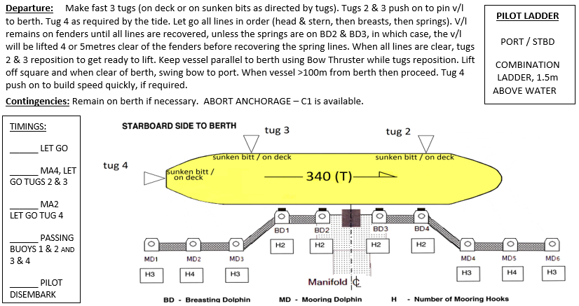
DLNG PASSAGE INFORMATION OUTWARDS
PIL-PP-15
Partnering in growth, connecting people and supporting potential
NAME OF VESSEL: ___________________________________ DATE: _____________________
POB TIME: ____________________ GT:__________________ DRAUGHT F: _______________
BERTH : ______________________ LOA:_________________ DRAUGHT A: _______________
STARBOARD SIDE ALONGSIDE – Refer to latest NTM for Declared Depths
THE PRINCIPLES OF BRIDGE RESOURCE MANAGEMENT MUST BE ADHERED TO AT ALL TIMES
MASTER:_________________________________ SIGNATURE:___________________________
PILOT:___________________________________ SIGNATURE:___________________________
Teamwork | Respect | Integrity | Honesty | Safety

Slide 2
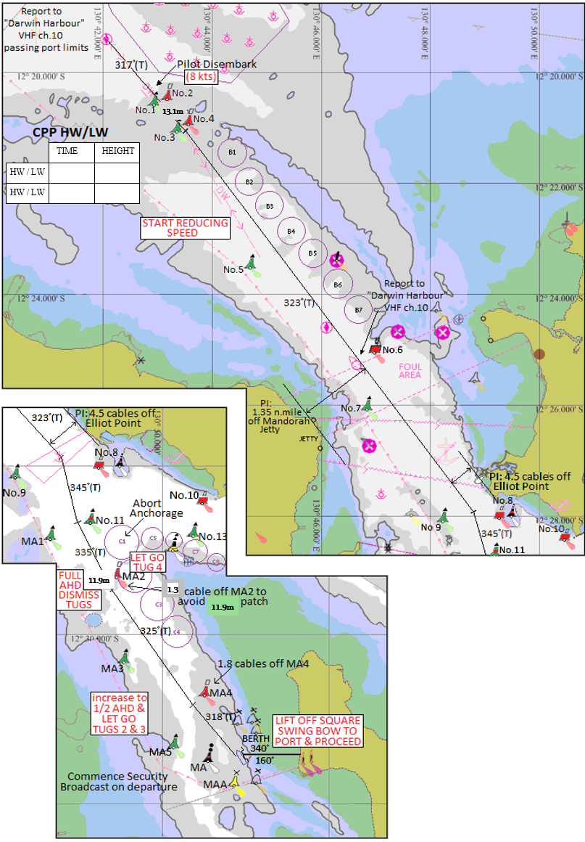
DLNG PASSAGE INFORMATION OUTWARDS
PIL-PP-15
Partnering in growth, connecting people and supporting potential
BRIDGE TEAM:
MAINTAIN LOOKOUT VISUALLY AND BY RADAR. FOLLOW PILOT PASSAGE PLAN AND INFORM WHEN THERE IS AN OBSERVED DEVIATION FROM THE AGREED PLAN.
*IF IN DOUBT CONSULT PILOT*
MOORING LINES FOR DEPARTURE:
LET GO AND RECOVER ALL LINES IN ORDER.
ONLY SLACK AND LET GO LINES WHEN TOLD TO DO SO BY THE PILOT.
HEAD AND STERN LINES FIRST, THEN BREASTS, THEN SPRINGS LAST.
MOORING HOOKS: SWL 125t
MOORING HOOK ALARMS SET TO 40t
TUG INFORMATION:
SVITZER STOCKTON & MACQUARIE: ASD 82T
SVITZER PALMERSTON & STOKES: ASD 83T
MATARANKA: ASD 70T
FIONA
Critical Depth
Critical Depth
BERTHING LIMITS
Wind: 20kts (unless SE'ly then 25kts)
Tide: 3kts
DEPTHS:
As per latest NTM: Declared Depths
12.1m
PLEASE NOTE:
* THE CHARTS USED ON THIS PASSAGE PLAN ARE NOT TO SCALE. THESE CHARTS FORM PART OF THE MASTER/PILOT EXCHANGE AND ARE FOR INFORMATION ONLY. NAVIGATIONAL CHARTS AND/OR APPROVED ECDIS SHOULD BE REFERRED TO IN ALL CASES.
* INDICATED COURSES ARE A GUIDELINE ONLY. VESSEL'S ROUTE IS TO BE DISCUSSED DURING THE MASTER/PILOT EXCHANGE AND AGREED TO BY THE MASTER.
* THE SHIP'S POSITION, THE VESSEL'S CONDITION AND HARBOUR TRAFFIC ARE TO BE MONITORED THROUGHOUT THE PASSAGE BY THE BRIDGE TEAM.
* THE BRIDGE TEAM MUST IMMEDIATELY MAKE THE PILOT AWARE OF ANY CONCERNS OR ANYTHING NOT UNDERSTOOD
Teamwork | Respect | Integrity | Honesty | Safety

Slide 3
DLNG PASSAGE INFORMATION OUTWARDS
PIL-PP-15
Partnering in growth, connecting people and supporting potential
DARWIN PILOT PASSAGE PLAN
Route: DLNG to Outer Pilot Boarding Ground
OUTWARD BOUND
TOTAL DIST 14.8nm
Waypoint Name | LAT | LONG | Course x Distance to next Waypoint | Total Distance to Waypoint | Comments
DLNG Berth | 12º 31.434’ S | 130º 50.913’ E | 318º x 0.8nm
MA4 Buoy | 12º 30.819’ S | 130º 50.346’ E | 325º x 1.6nm | 0.8nm | Pass 0.18nm off MA4 Buoy
MA2 Buoy | 12º 29.483’ S | 130º 49.388’ E | 335º x 1.0nm | 2.4nm | Pass 0.13nm off MA2 Buoy
No.11 Buoy | 12º 28.585’ S | 130º 48.959’ E | 345º x 0.7nm | 3.4nm | Pass 0.10nm off No.11 Buoy
Elliott Point | 12º 27.943’ S | 130º 48.783’ E | 323º x 8.6nm | 4.1nm | Pass 0.45nm off Elliott Point
3 & 4 Buoys | 12º 21.108’ S | 130º 43.518’ E | 317º x 2.1nm | 12.7nm | Pass 1.35nm off Mandorah Jetty
OPBG | 12º 19.561’ S | 130º 42.042’ E |  | 14.8nm
Teamwork | Respect | Integrity | Honesty | Safety

