Slide 1

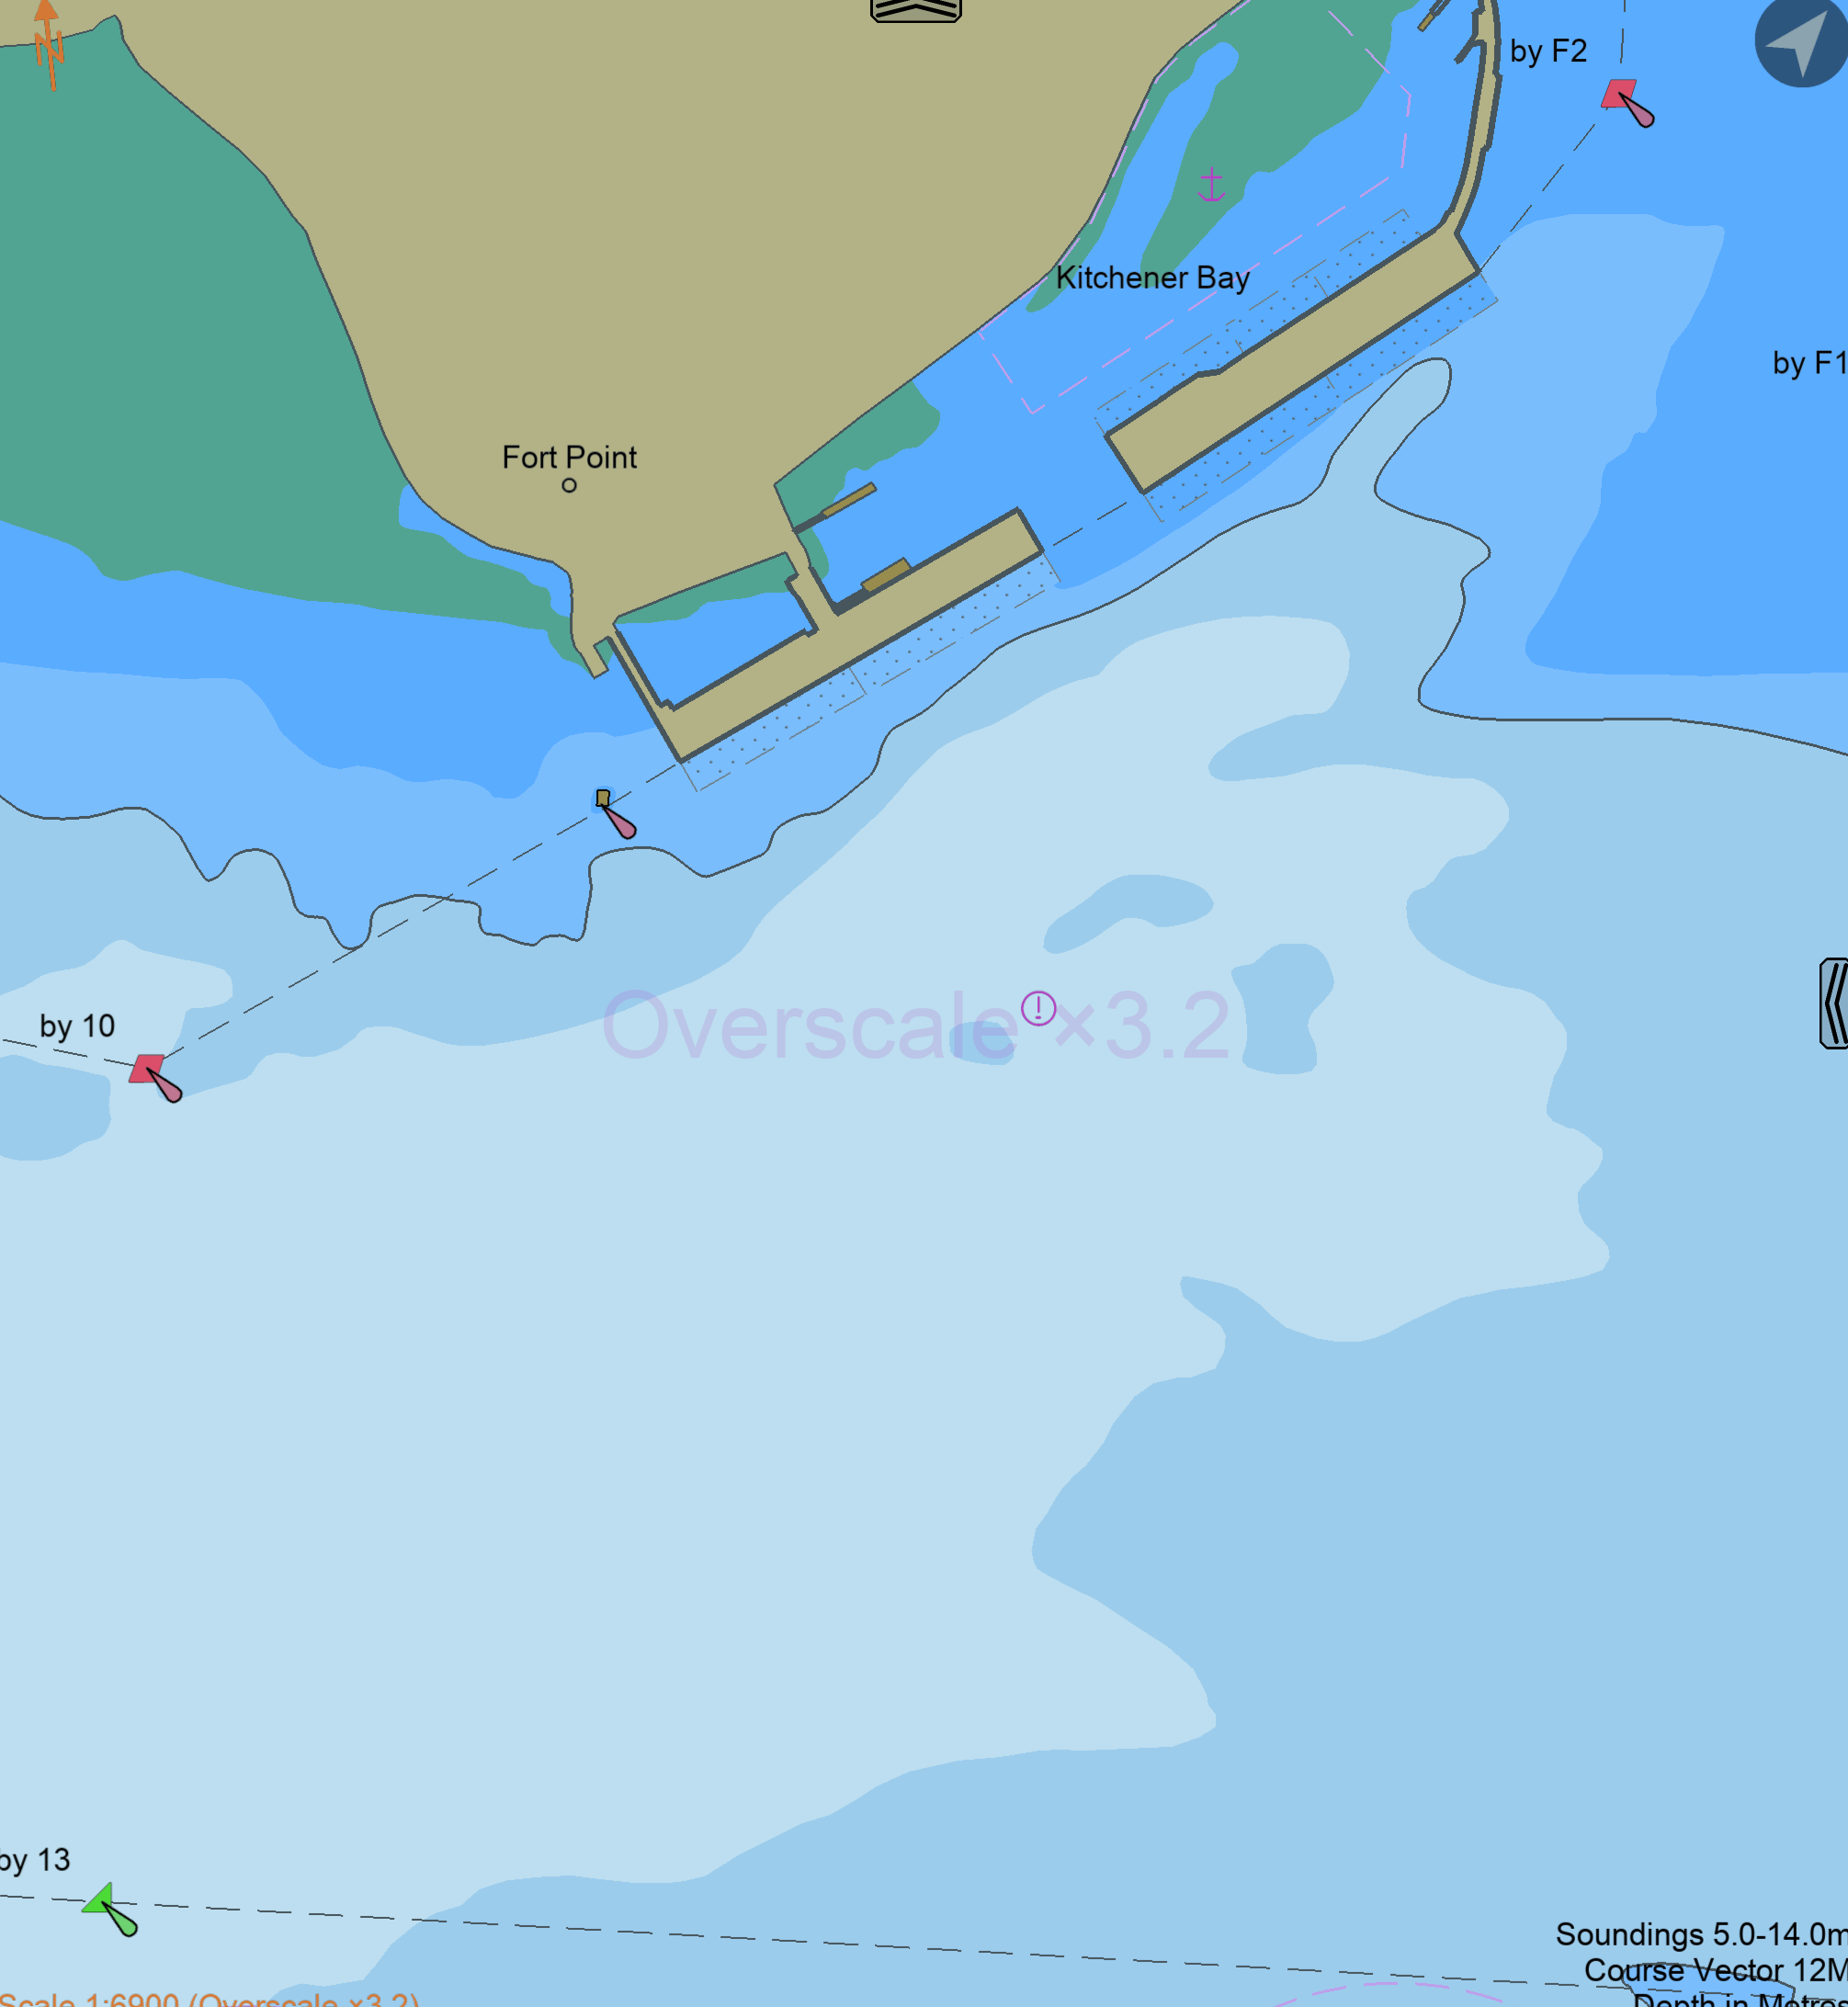
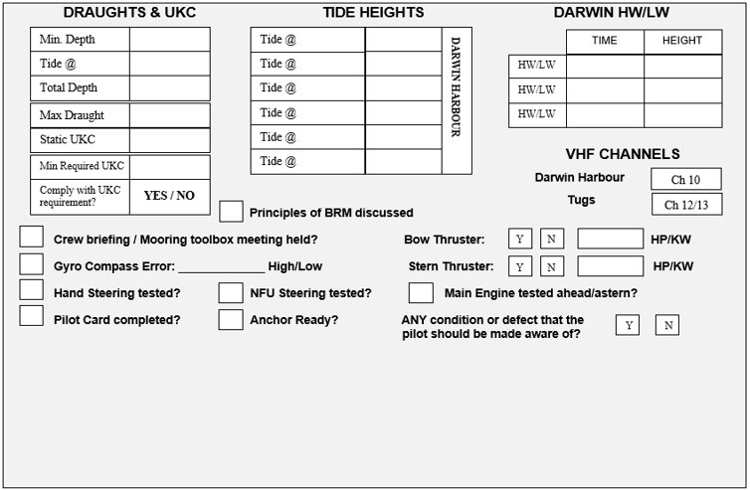
FHW PASSAGE PLAN
PIL-PP-17
Partnering in growth, connecting people and supporting potential
NAME OF VESSEL:_________________________ DATE:_______________
POB TIME:______________ GT:__________ DRAUGHT A:________
BERTH: Fort Hill Wharf: LOA:__________ DRAUGHT F:_________
Refer to Latest NTM for Declared Depths
THE PRINCIPLES OF BRIDGE RESOURCE MANAGEMENT MUST BE ADHERED TO AT ALL TIMES
MASTER:________________________________________ SIGNATURE:___________________________________
PILOT:___________________________________________ SIGNATURE:___________________________________
Teamwork | Respect | Integrity | Honesty | Safety Revised March 2026

Slide 2
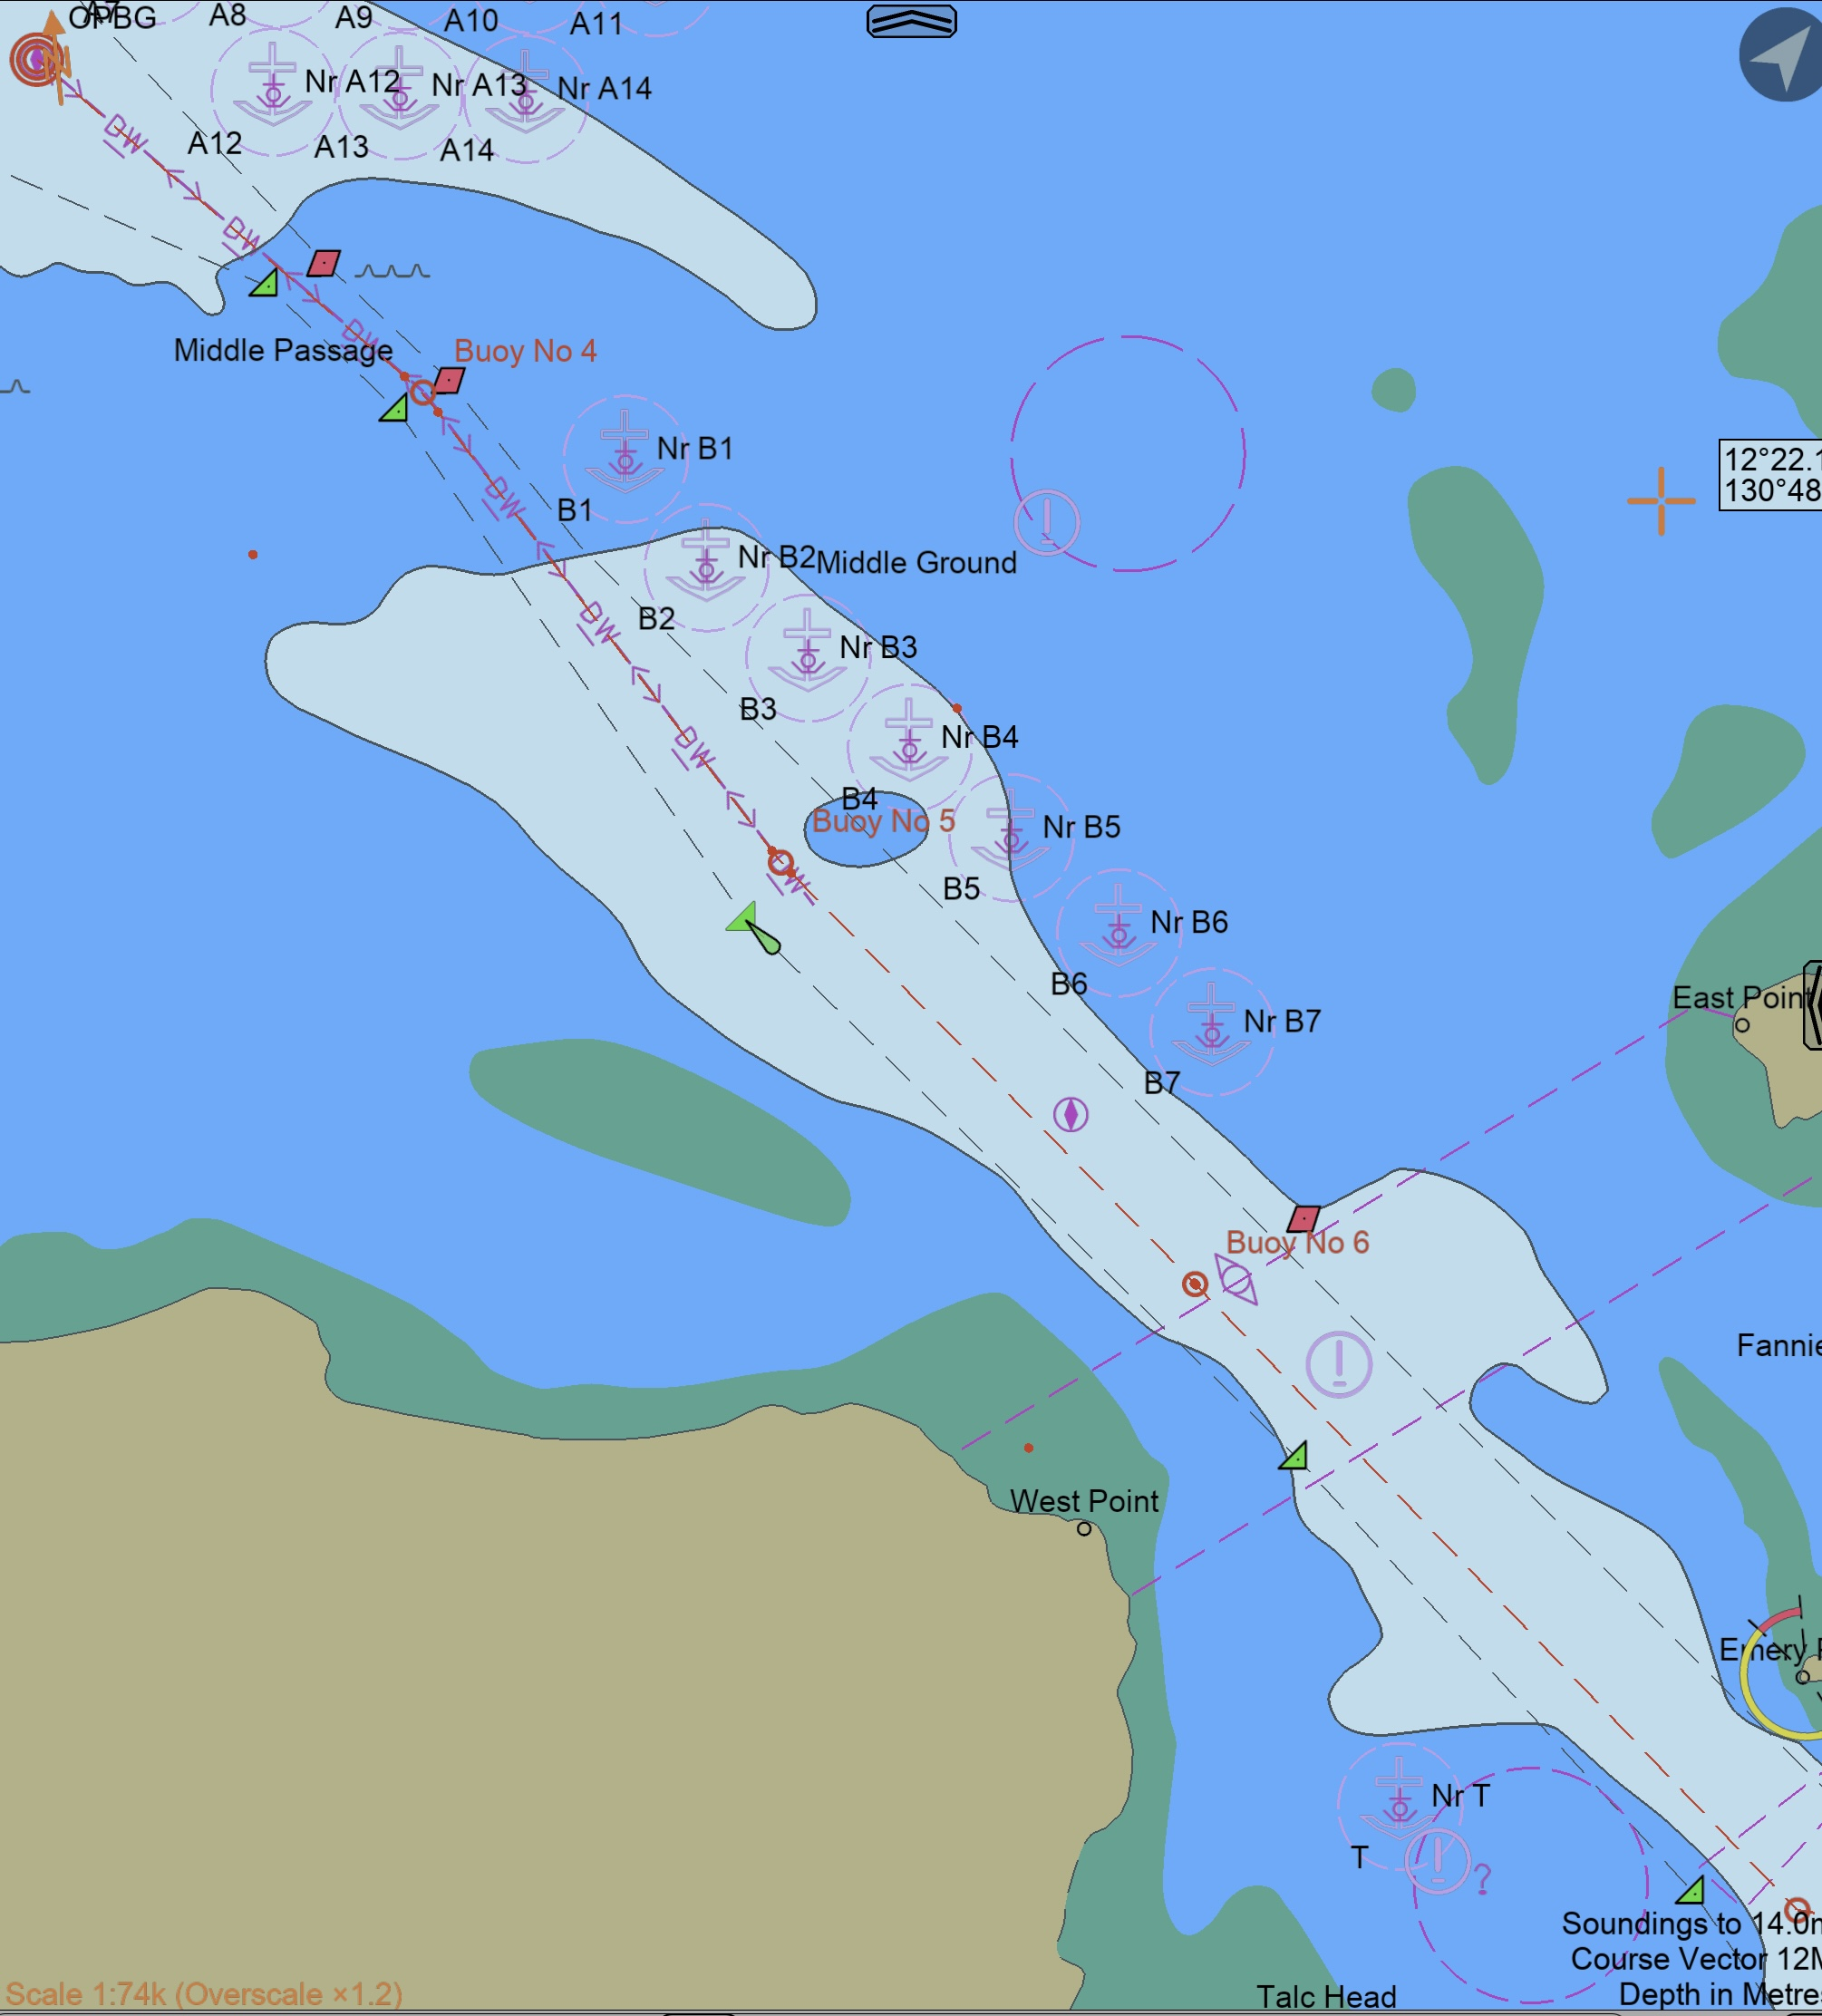
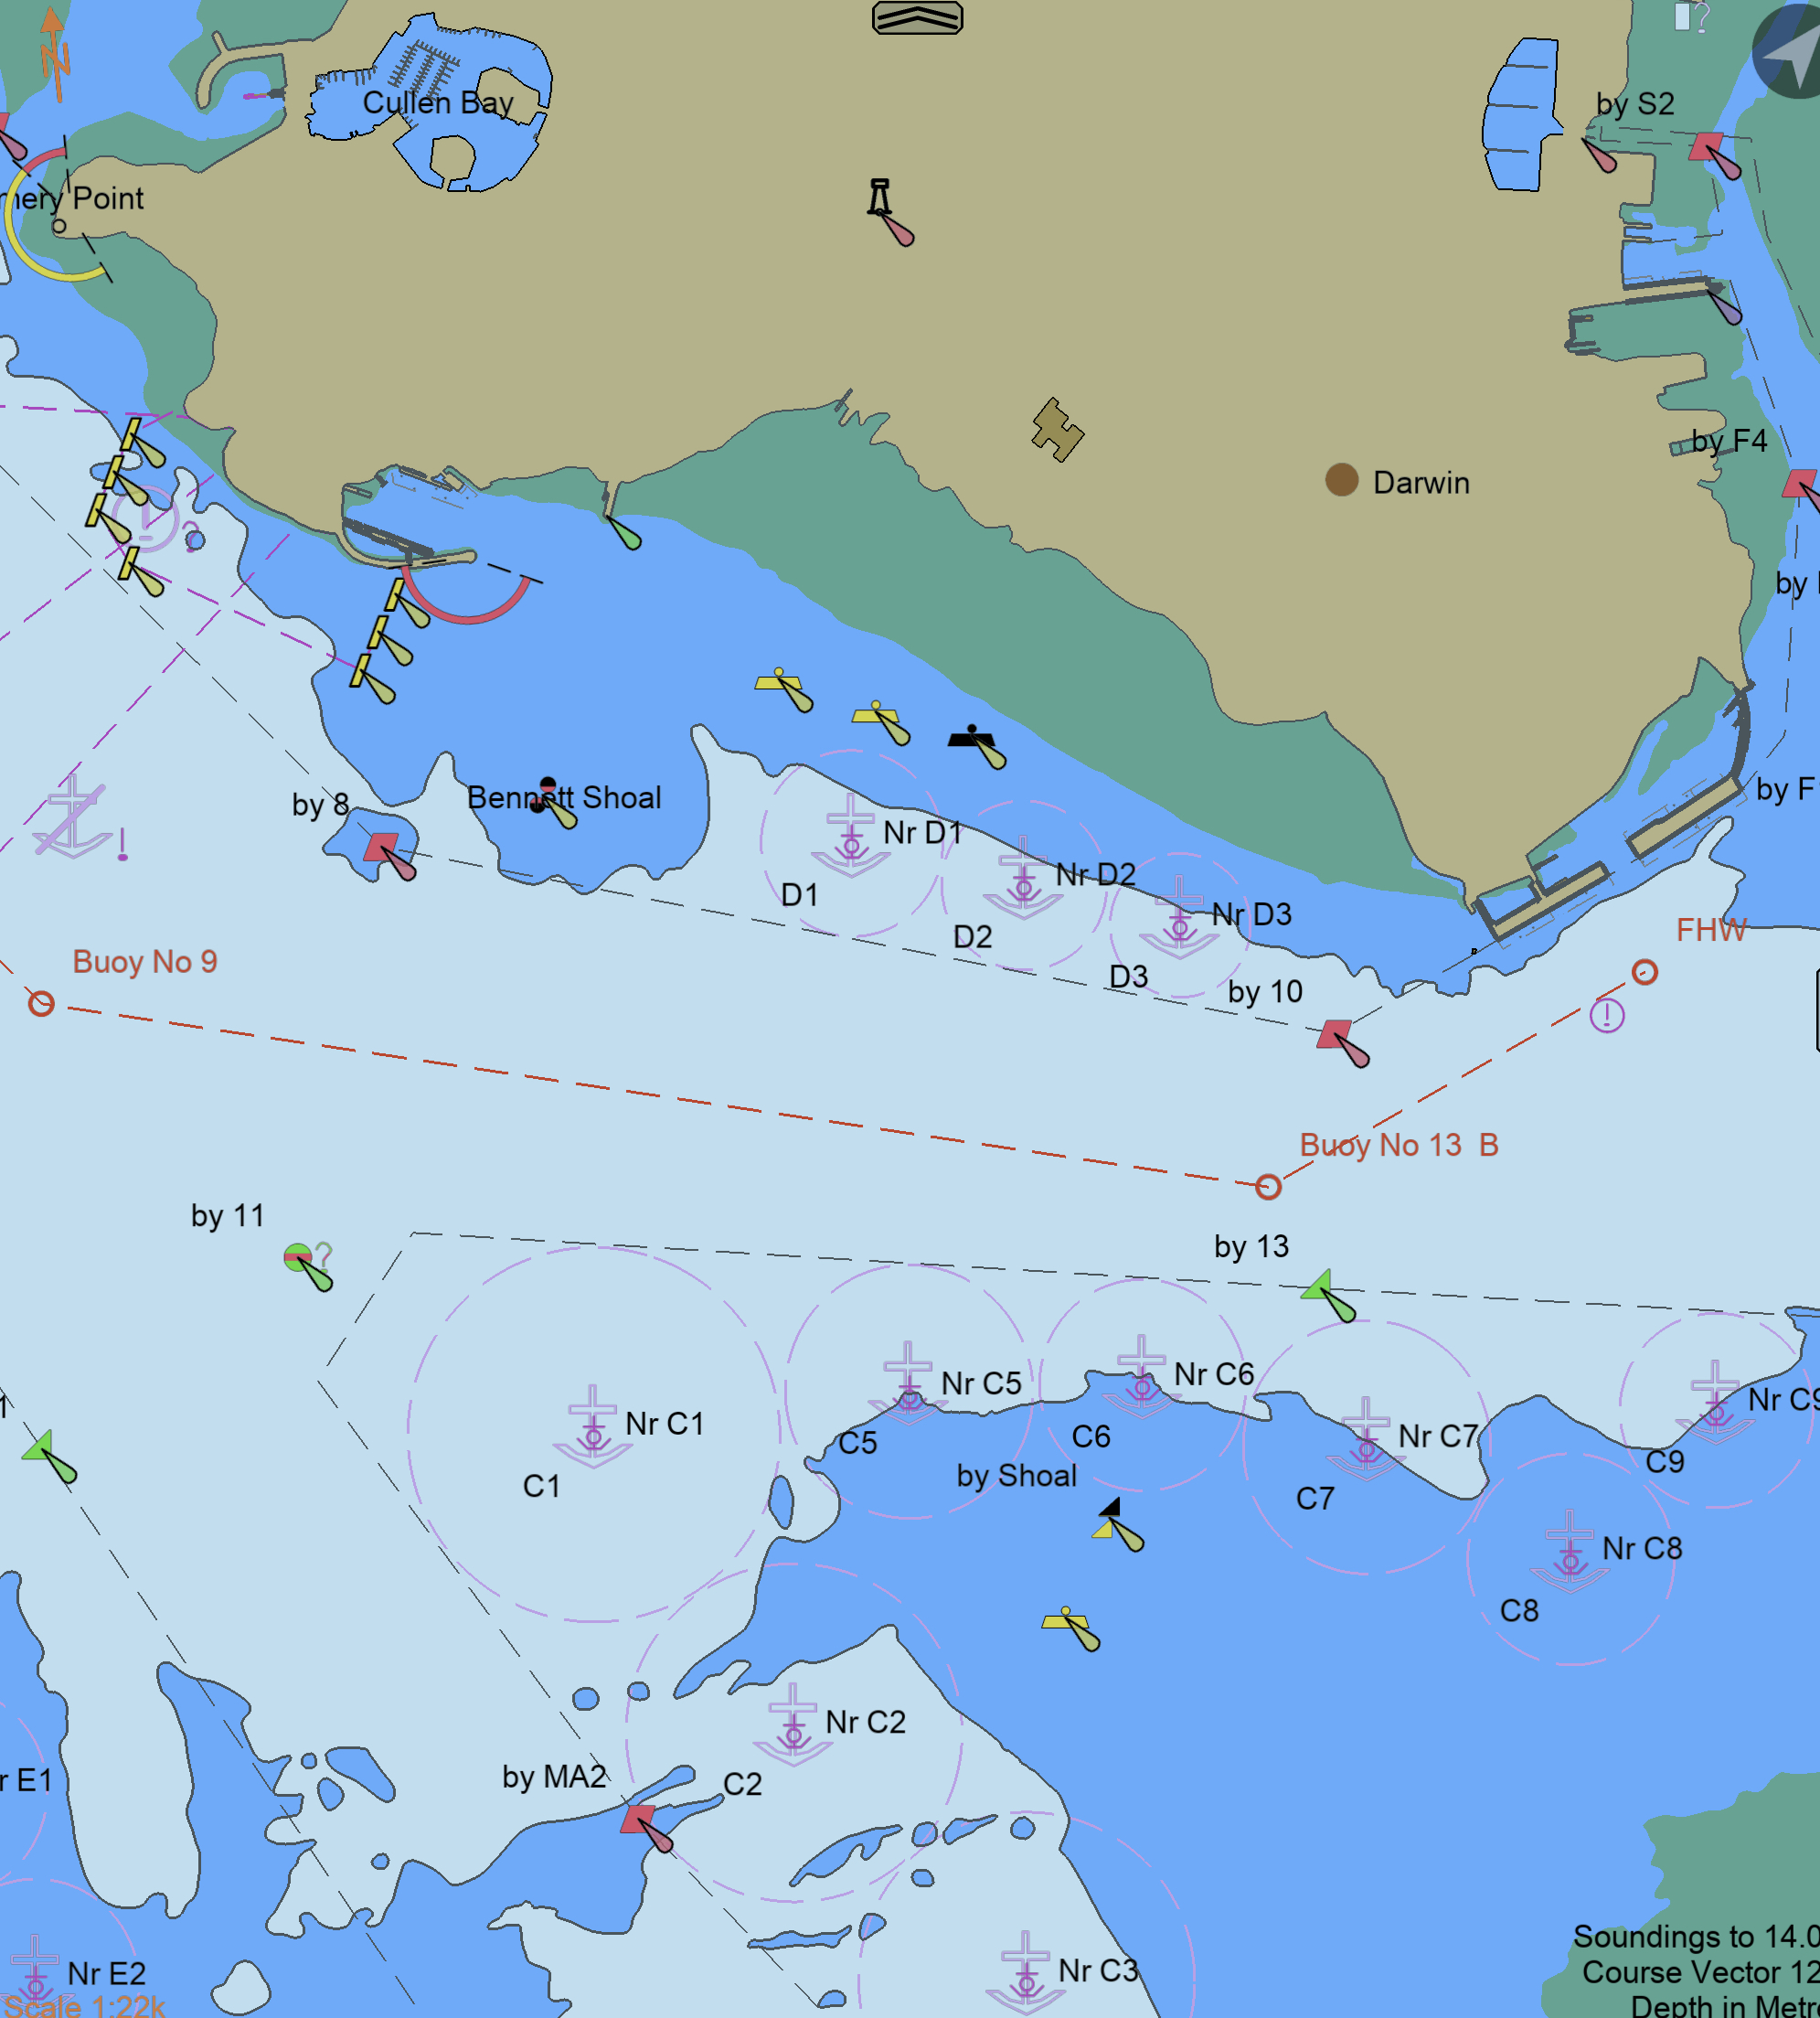
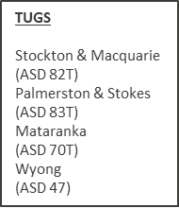
FHW PASSAGE PLAN
PIL-PP-17
Partnering in growth, connecting people and supporting potential
Bridge Team:
MAINTAIN LOOKOUT VISUALLY AND BY
RADAR. FOLLOW PILOT PASSAGE PLAN AND INFORM WHEN THERE IS AN OBSERVED DEVIATION FROM THE AGREEDV PLAN.
IF IN DOUBT SPEAK OUT
12.5m
PLEASE NOTE:
THE CHARTS USED ON THIS PASSAGE PLAN ARE NOT TO SCALE. THESE CHARTS FORM PART OF THE MASTER/ PILOT EXCHANGE AND ARE FOR INFORMATION ONLY. NAVIGATIONAL CHARTS AND/OR APPROVED ECDIS SHOULD BE REFERRED TO IN ALL CASES.
INDICATED COURSES ARE A GUIDELINE ONLY. VESSEL’S ROUTE IS TO BE DISCUSSED DURING THE MASTER/PILOT EXCHANGE AND AGREED TO BY THE MASTER.
THE SHIP’S POSITION, THE VESSEL’S CONDITION AND HARBOUR TRAFFIC ARE TO BE MONITORED THROUGHOUT THE PASSAGE BY THE BRIDGE TEAM.
THE BRIDGE TEAM MUST IMMEDIATELY MAKE THE PILOT AWARE OF ANY CONCERNS OR ANYTHING NOT UNDERSTOOD
Teamwork | Respect | Integrity | Honesty | Safety

