Slide 1

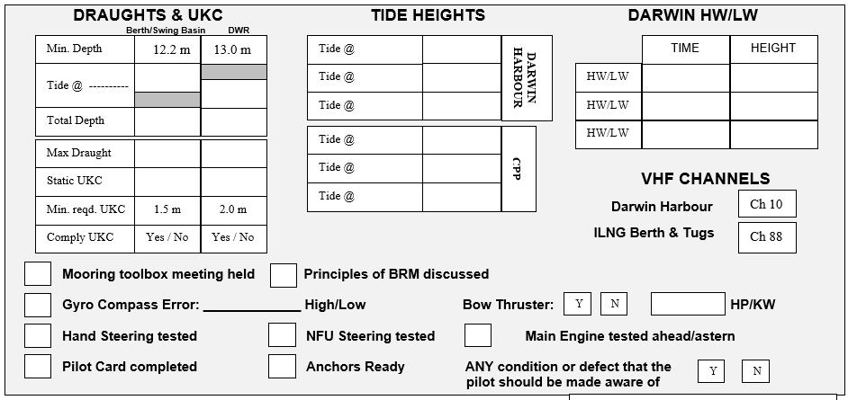
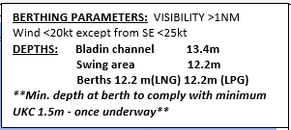
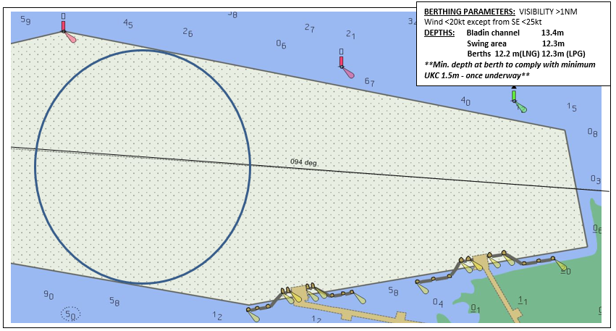
INPEX ILNG & ILPG PASSAGE INFORMATION OUTWARDS
PIL-PP-19
Partnering in growth, connecting people and supporting potential
NAME OF VESSEL: ___________________________________ DATE: _____________________
POB TIME: ____________________ GT:__________________ DRAUGHT F: _______________
BERTH : ILPG/ILNG LOA:_________________ DRAUGHT A: _______________
PORTSIDE ALONGSIDE – Refer to latest NTM for Declared Depths
ILPG Berth & Tugs
Ch 88
Berthing Parameters
Visibility >1nm
Wind <20kt except from the SE <25kts
**Min. depth at berth to comply with minimum
UKC 1.5m once underway**
13.5m
11.9m
11.7m
11.6m
THE PRINCIPLES OF BRIDGE RESOURCE MANAGEMENT MUST BE ADHERED TO AT ALL TIMES
MASTER:_________________________________ SIGNATURE:___________________________
PILOT:___________________________________ SIGNATURE:___________________________
Teamwork | Respect | Integrity | Honesty | Safety

Slide 2
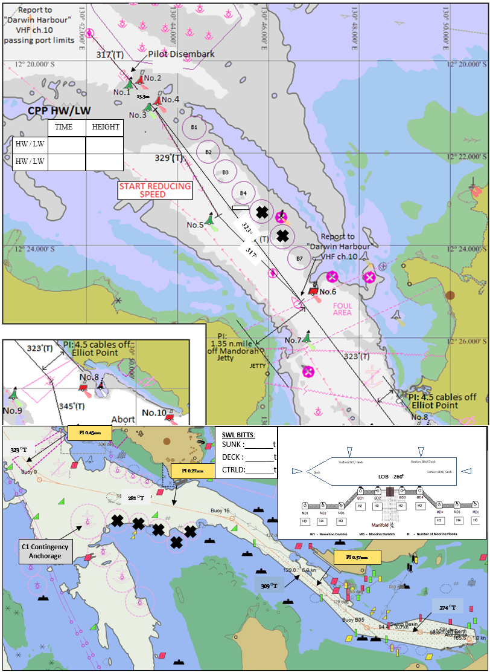
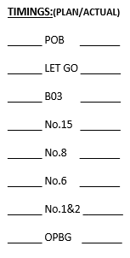
INPEX ILNG & ILPG PASSAGE INFORMATION OUTWARDS
PIL-PP-19
Partnering in growth, connecting people and supporting potential
BRIDGE TEAM:
MAINTAIN LOOKOUT VISUALLY AND BY ALL AVAILABLE MEANS. FOLLOW PILOT PASSAGE PLAN & INFORM WHEN THERE IS AN OBSERVED DEVIATION FROM THE AGREED PLAN.
*IF IN DOUBT CONSULT PILOT*
MOORING LINES ON ARRIVAL:
ALL LINES ASHORE WITH HEAVING LINES AND YOYO GEAR. ONE LINE AT A TIME.
SPRINGS FIRST, THEN BREASTS, THEN HEAD/STERN LINES.
DON'T HEAVE UP UNTIL MOORING MEN ARE CLEAR OF MOORING DOLPHINS.
MOORING HOOKS: SWL 125t
MOORING HOOK ALARMS SET TO 40t
TUG INFORMATION:
STOCKTON & MACQUARIE: ASD 82T
PALMERSTON & STOKES: ASD 83T
MATARANKA: ASD 70T
Critical Depths
PLEASE NOTE:
* THE CHARTS USED ON THIS PASSAGE PLAN ARE NOT TO SCALE. THESE CHARTS FORM PART OF THE MASTER/PILOT EXCHANGE AND ARE FOR INFORMATION ONLY. NAVIGATIONAL CHARTS AND/OR APPROVED ECDIS SHOULD BE REFERRED TO IN ALL CASES.
* INDICATED COURSES ARE A GUIDELINE ONLY. VESSEL'S ROUTE IS TO BE DISCUSSED DURING THE MASTER/PILOT EXCHANGE AND AGREED TO BY THE MASTER.
* THE SHIP'S POSITION, THE VESSEL'S CONDITION AND HARBOUR TRAFFIC ARE TO BE MONITORED THROUGHOUT THE PASSAGE BY THE BRIDGE TEAM.
* THE BRIDGE TEAM MUST IMMEDIATELY MAKE THE PILOT AWARE OF ANY CONCERNS OR ANYTHING NOT UNDERSTOOD
Teamwork | Respect | Integrity | Honesty | Safety

Slide 3
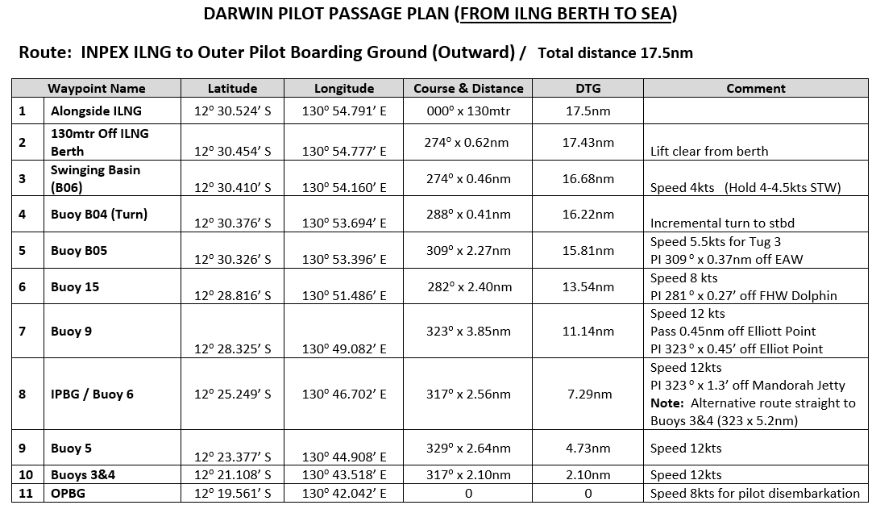
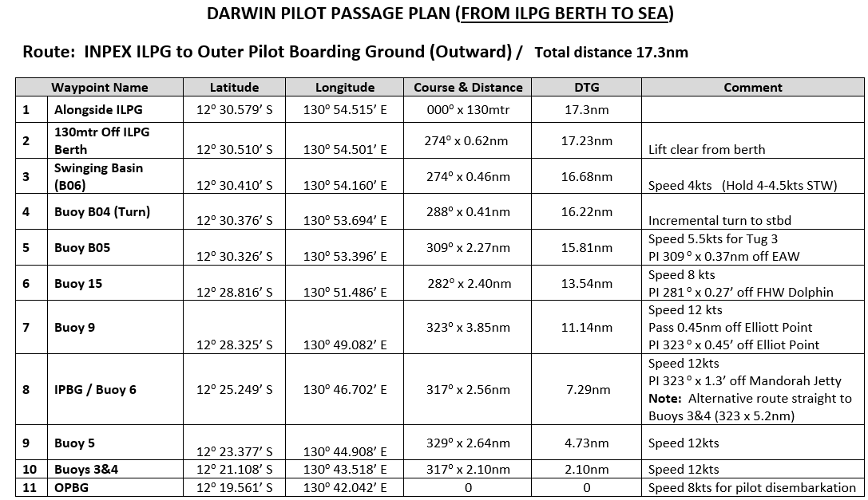
INPEX ILNG & ILPG INFORMATION OUTWARDS
PIL-PP-19
Partnering in growth, connecting people and supporting potential
Teamwork | Respect | Integrity | Honesty | Safety

