Slide 1

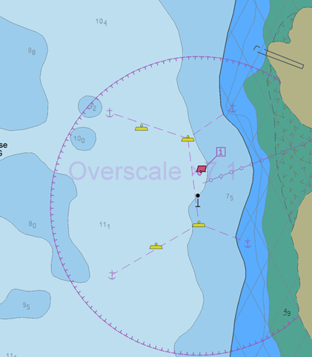
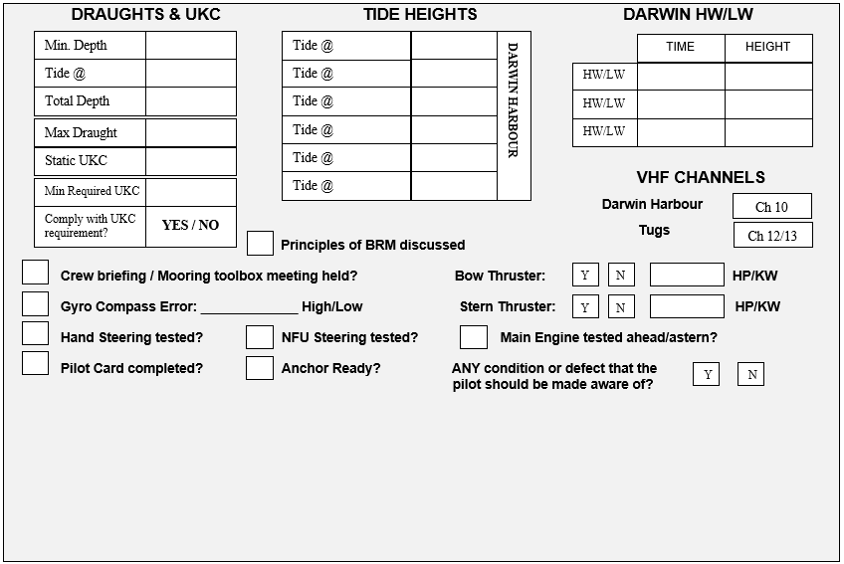
CHANNEL Is. PASSAGE PLAN
PIL-PP-13
Partnering in growth, connecting people and supporting potential
NAME OF VESSEL:_________________________ DATE:_______________
POB TIME:______________ GT:__________ DRAUGHT A:________
BERTH: Channel Is. LPG LOA:__________ DRAUGHT F:_________
THE PRINCIPLES OF BRIDGE RESOURCE MANAGEMENT MUST BE ADHERED TO AT ALL TIMES
MASTER:_________________________________________ SIGNATURE:___________________________________
PILOT:___________________________________________ SIGNATURE:___________________________________
Teamwork | Respect | Integrity | Honesty | Safety Revised March 2026

Slide 2
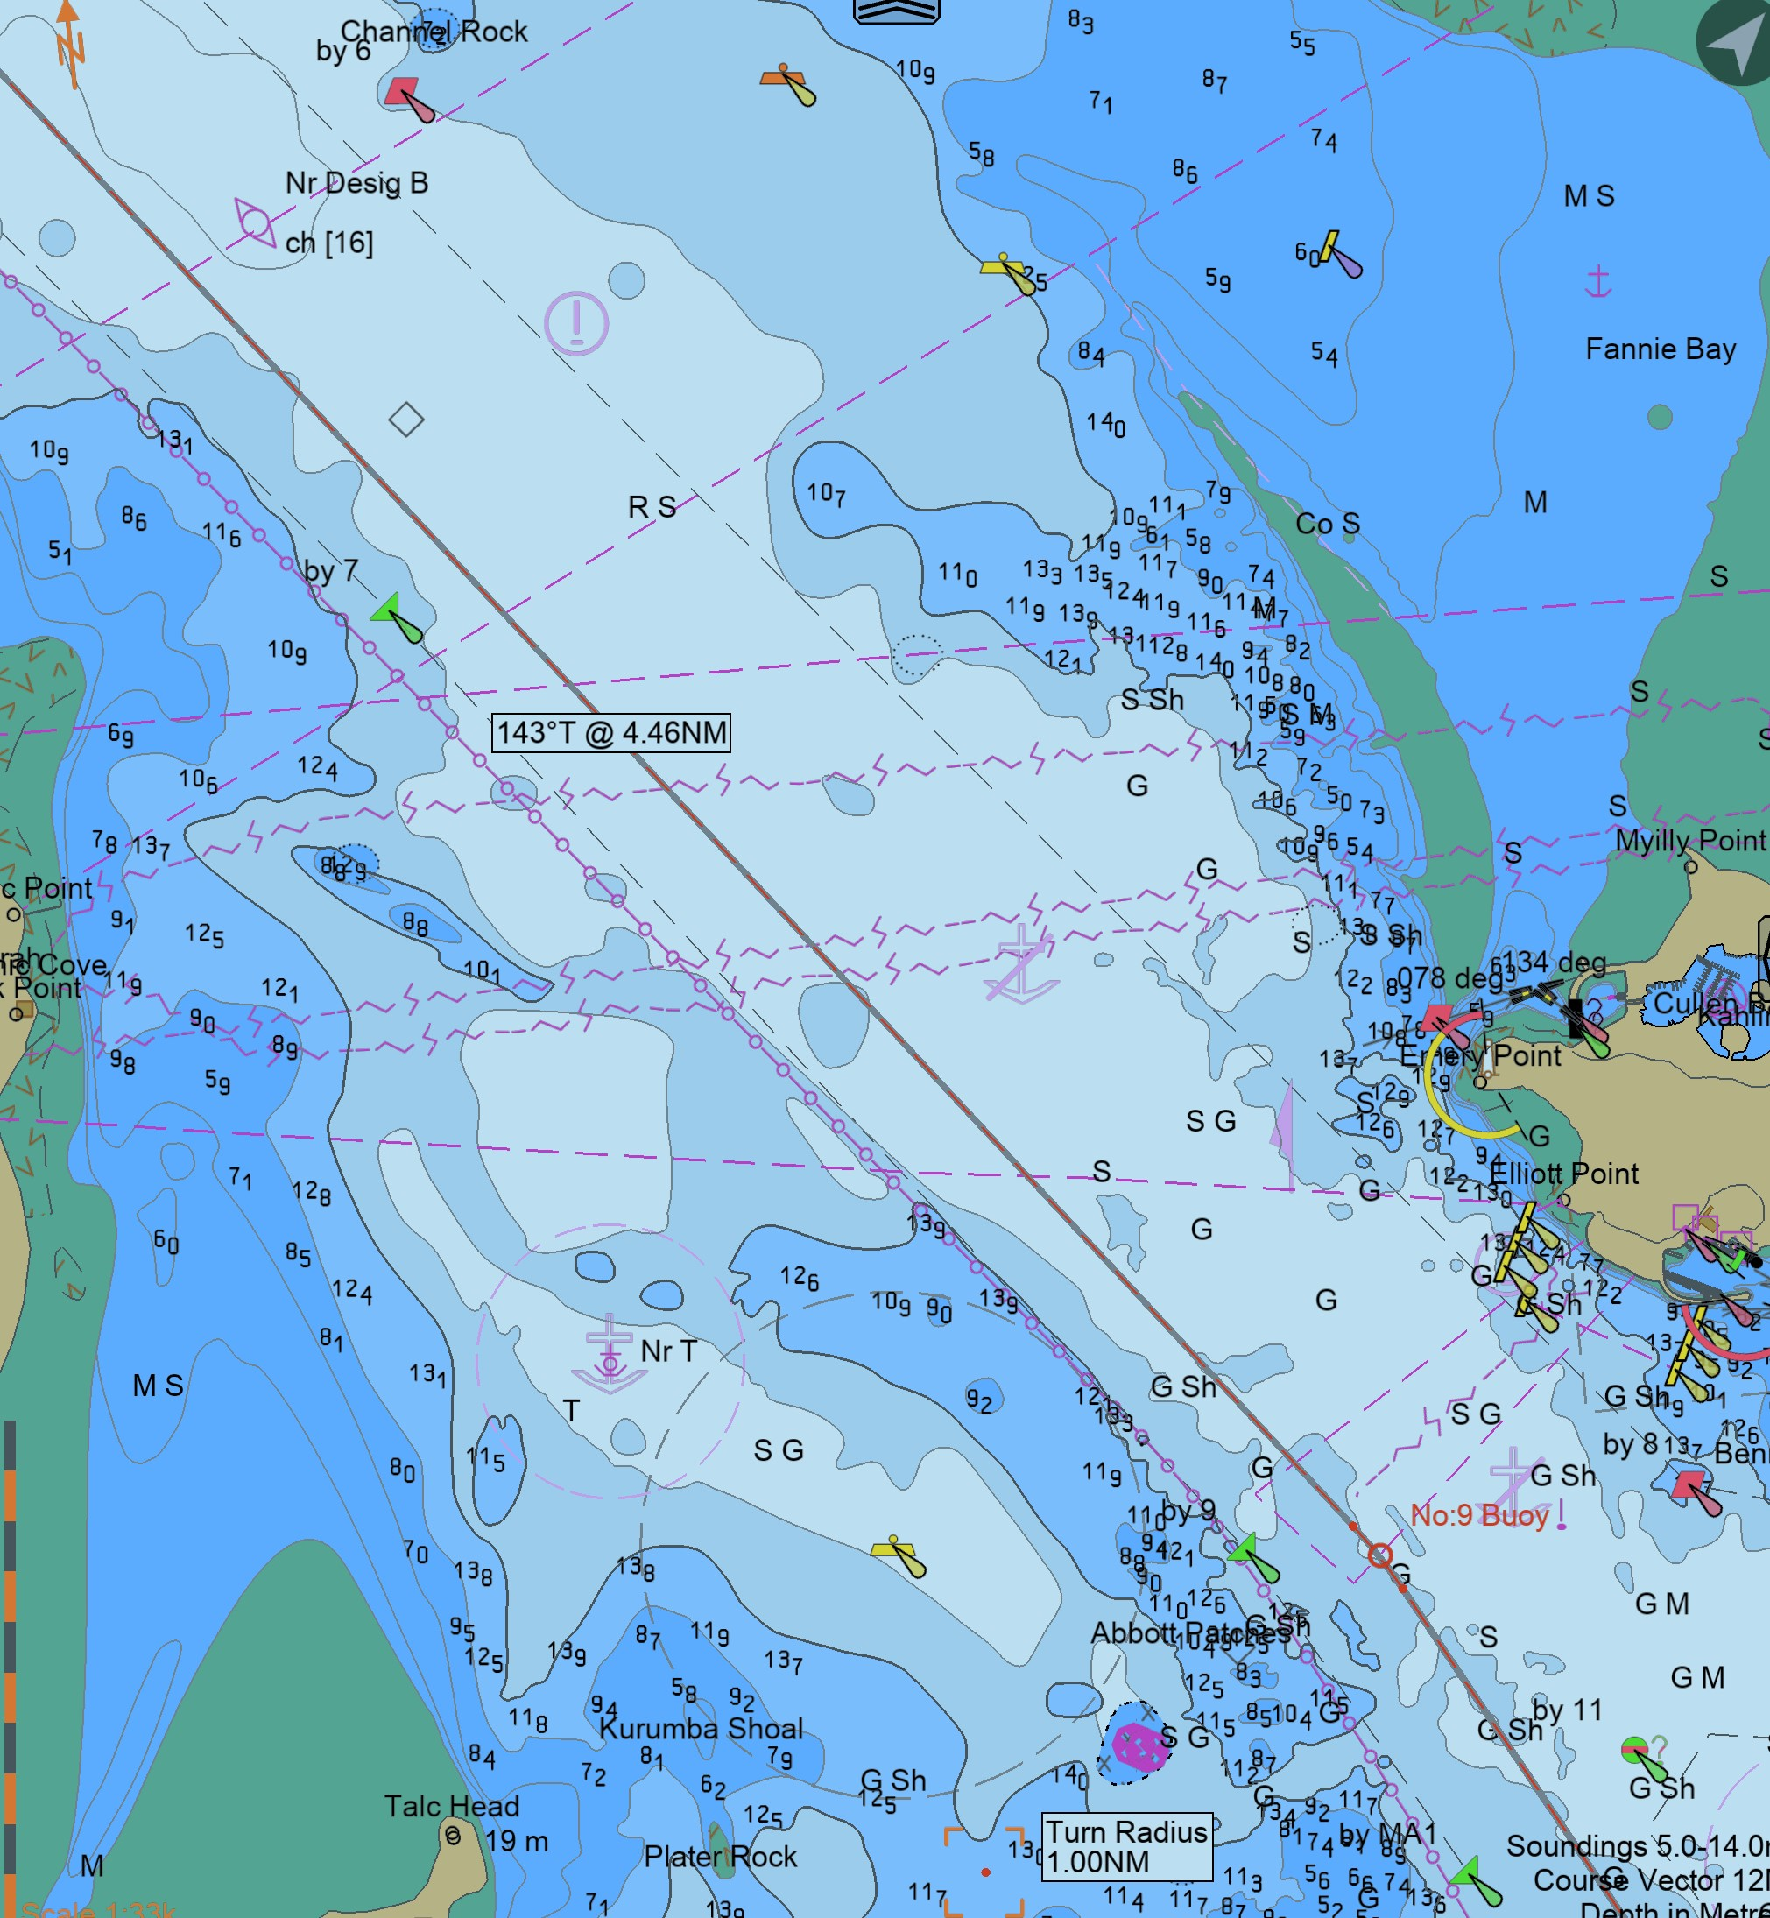
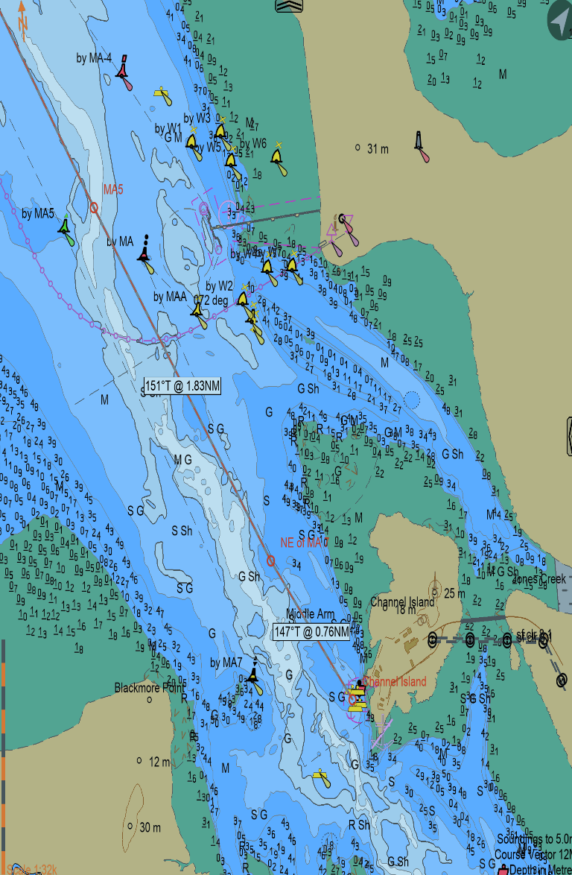
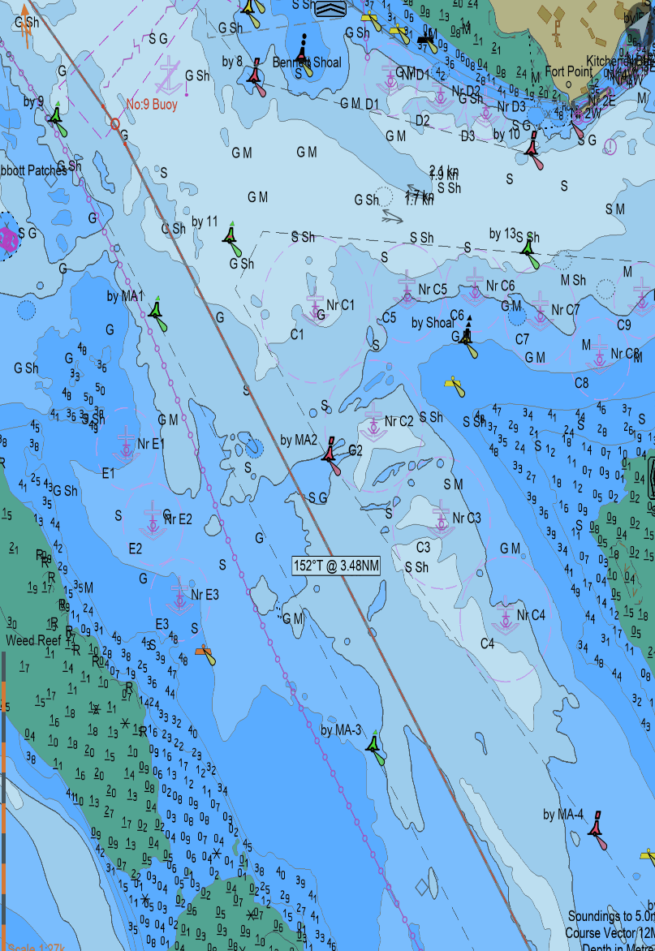
CHANNEL Is. PASSAGE PLAN
PIL-PP-13
Partnering in growth, connecting people and supporting potential
6.3
Teamwork | Respect | Integrity | Honesty | Safety

